Slide 1
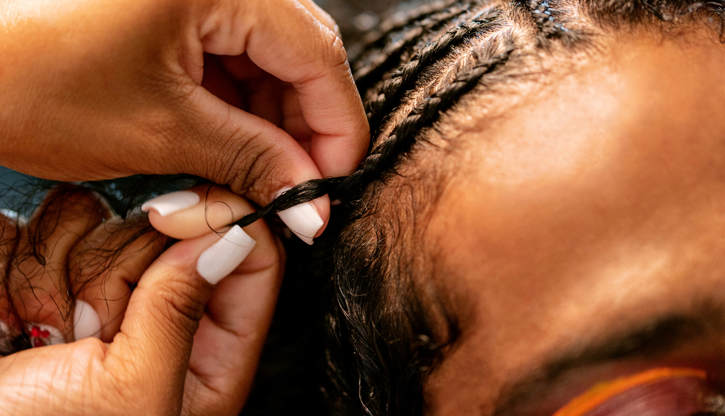
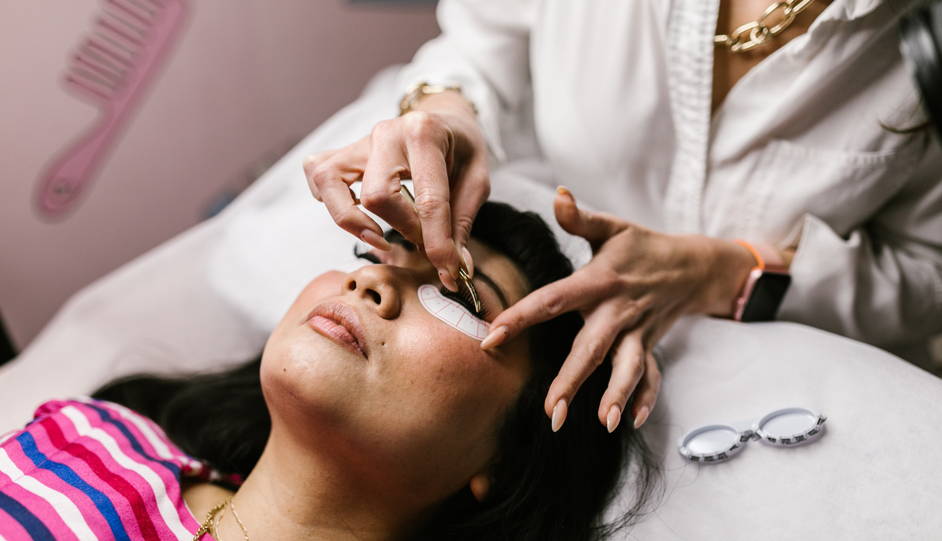
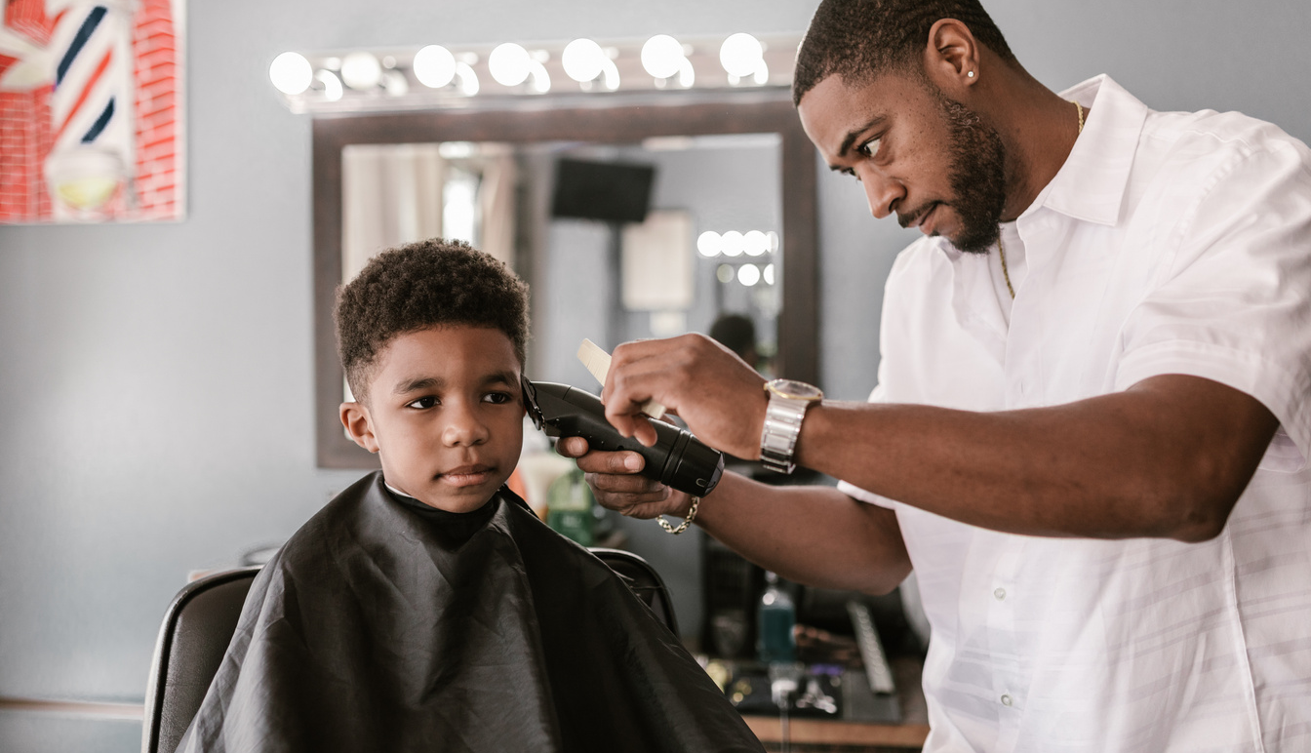
The Beauty Experience Conference is dedicated to empowering beauty professionals in the cosmetology, esthetician, and related industries to enhance their client experience. We strive to provide a dynamic platform that fosters knowledge sharing, skill development, and industry collaboration. Our mission is to equip beauty professionals with the tools and insights they need to cultivate client loyalty and ensure long-term sustainability in their businesses.

Slide 2
A Message From The Team

Slide 3
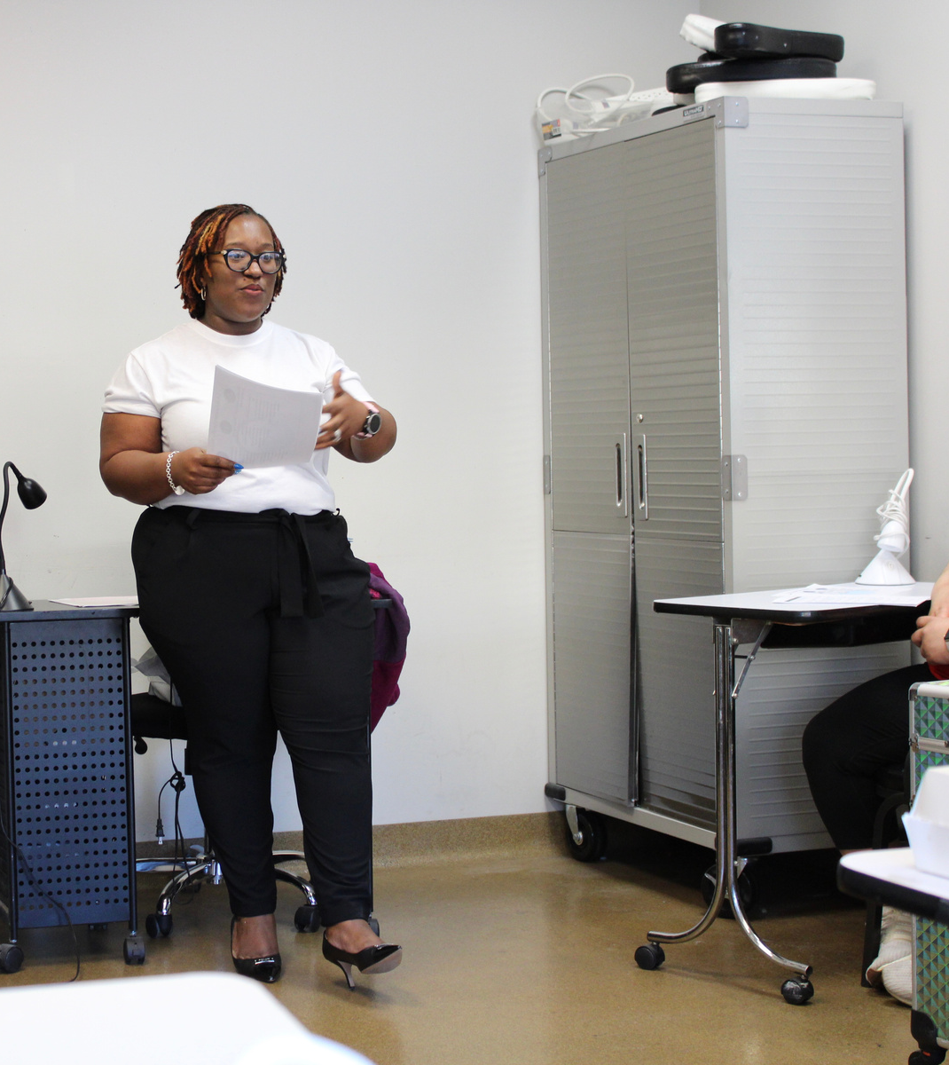
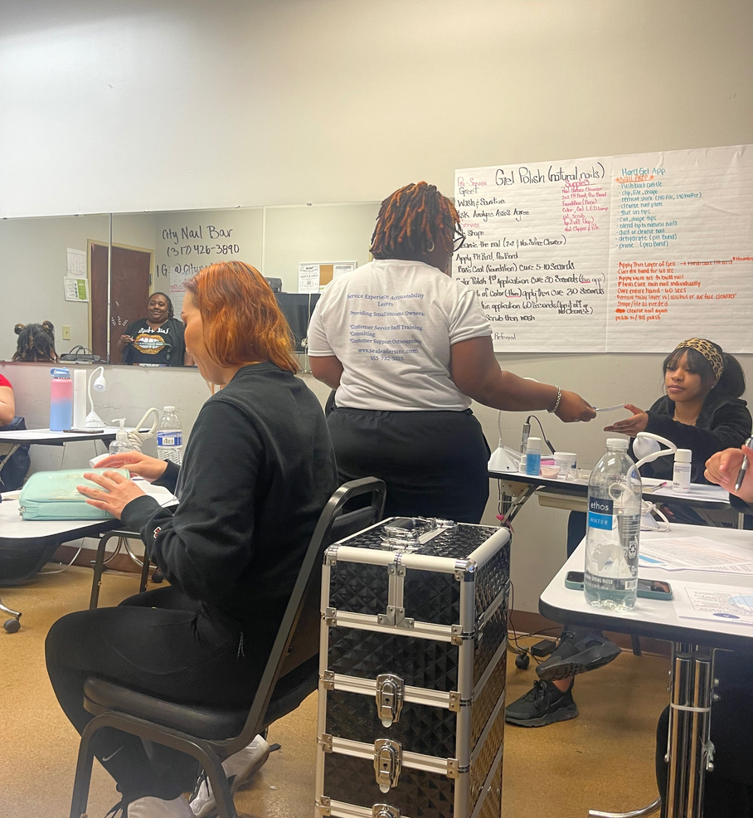
ABOUT US: OUR VISION
Our vision is to create an unparalleled conference experience where beauty
professionals, both men and women, come together to elevate their craft and transform the client experience. We envision a future where every beauty professional is equipped with the knowledge, skills, and innovative techniques necessary to exceed client expectations.
Through our convention, we aim to inspire and empower industry professionals to build strong client relationships, foster loyalty, and promote sustainable growth in their careers.
BETTER PRACTICES AWAIT.
By fostering a culture of continuous learning, networking, and industry best practices, we strive to be the leading platform that champions excellence in the beauty industry. We envision a community of passionate professionals who are committed to raising the bar in client satisfaction and setting new standards of excellence in the beauty world.
Together, we can shape the future of the beauty industry and create a lasting impact on the lives of beauty professionals and their valued.

Slide 4
SPONSORSHIP OPPORTUNITIES

Slide 5
SPONSORSHIP
PLATINUM $5,000
1 Complimentary table in the lobby area.
5 Wristbands for staff/guests to attend the conference.
Dedicated 1-hour slot for speaking, marketing, class or demonstration from your company at the conference on the event stage at the conference.
Your company name and/or logo printed on marketing materials and promotional opportunities.
Company highlighted throughout the event.
Company acknowledgement on our website with a web link to your personal site.
Your Organization’s Banner displayed in the main event hall.
Logo listed on the back of the volunteer shirts.
Your company marketing materials, products and promotional items inside of our 100 VIP and sample-sized swag bags (*Must be provided).

Slide 6
SPONSORSHIP
GOLD | $2,500
Complimentary Vendor booths (10×10) in conference
3 wristbands for guests to attend the conference.
Dedicated 30-Minute slot for class or demonstration from your company at the conference.
Company logo acknowledgement on website with a web link and your organizations’ name mentioned at the event, as well as marketing materials.
Your company marketing materials, products and promotional items inside of our 100 VIP and sample-sized swag bags. (*Must be provided.)

Slide 7
SPONSORSHIP
MEN’S LOUNGE SPONSOR | $1,500
Men’s Lounge vendor space (10×20) at conference
Provide products catered to men for the Men’s Lounge Bag Giveaways.
Gift Card/ Gift Certificates for Men’s Services or items for use on your site.
Company logo and material throughout Men’s Lounge.
Email us at traininging@sealeadersinc.com if you would like to offer
something not mentioned above as an addition to our Men’s Lounge area!

Slide 8
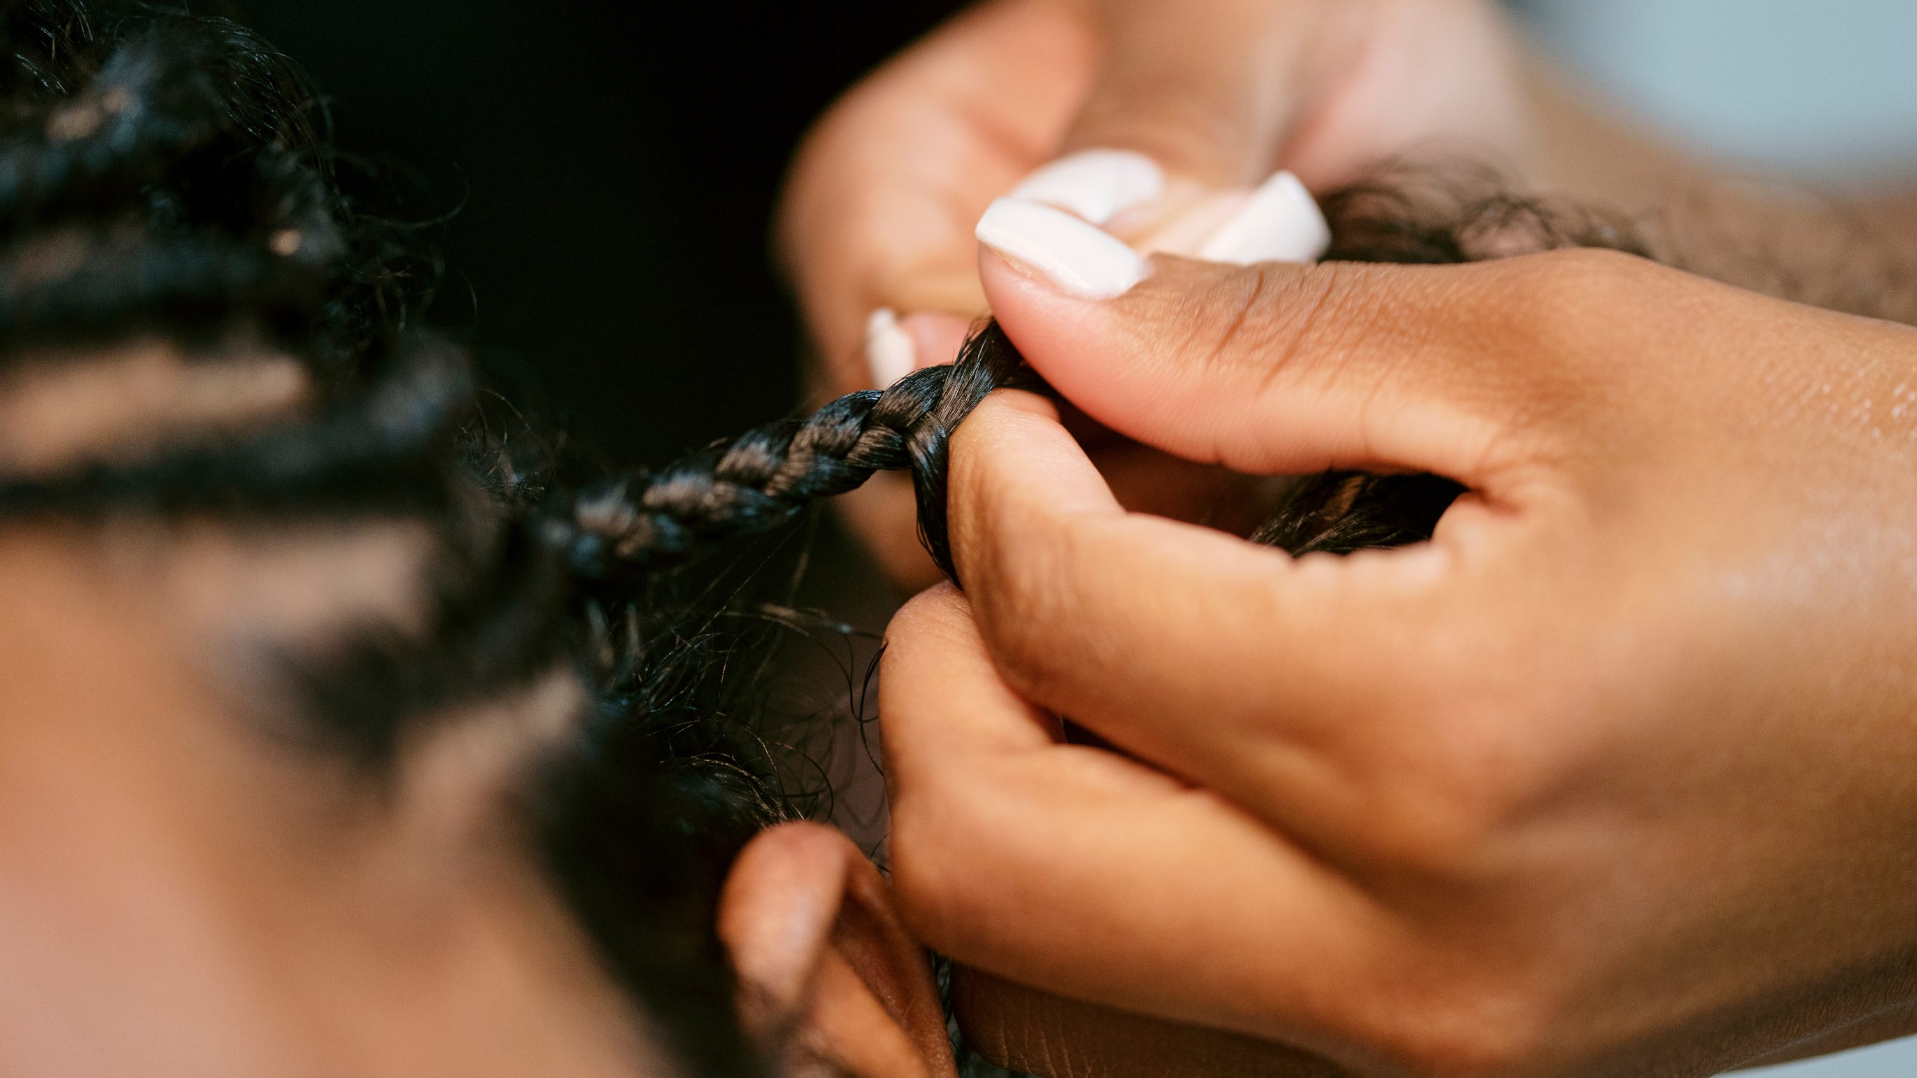
SPONSORSHIP
SPONSORSHIP
SILVER | $1,000
GOLD | $500
Complimentary vendor booth (10×10) at conference
2 Wristbands for guests to attend the conference.
Company logo acknowledgement on website with a web link and your organizations’ name mentioned at the event, as well as marketing materials.
Opportunity to your company marketing materials, products and promotional items inside of our 100 VIP and sample-sized swag bags. (With materials provided by you!)
1 Wristband guest to attend the conference.
Company logo acknowledgement on website with a web link and your organizations’ name mentioned at the event, as well as marketing materials.

Slide 9
01.
INDUSTRY EXPOSURE
Sponsors gain significant visibility and recognition within the beauty and cosmetology industry. Your conference attracts a wide range of professionals, providing sponsors with exposure to a diverse and engaged audience.
02.
BRAND RECOGNITION
Sponsors can leverage the conference to increase brand awareness and recognition. Your event will associate their brand with the values of empowerment, skill development, and collaboration, fostering positive perceptions among attendees.
BENEFITS OF
03.
NETWORKING
SPONSORSHIP
Sponsors have access to a network of beauty professionals, potential clients, and industry experts. This allows them to forge valuable connections, explore collaborations, and expand their business reach.
Sponsoring the Beauty Experience Conference can offer numerous benefits to sponsors, aligning with your mission to empower beauty professionals and enhance client experiences in the cosmetology, esthetician, and related industries.
Here are some compelling benefits for sponsors >>
04.
DEMONSTRATE PRODUCTS & SERVICES
Sponsors can showcase their products and services directly to beauty professionals actively seeking new solutions and tools to enhance client experiences. This creates a unique opportunity to engage with a highly targeted audience.
05.
THOUGHT LEADERSHIP
Sponsoring the conference positions sponsors as thought leaders in the industry. They can participate in panel discussions, workshops, or presentations to share their expertise and insights, positioning themselves as authorities in their respective niches.
06.
TARGETED MARKETING
Sponsors benefit from targeted marketing efforts that promote their involvement in the conference. This includes mentions in marketing materials, social media campaigns, and email newsletters, ensuring their message reaches a receptive audience.

Slide 10
07.
ACCESS TO DATA AND INSIGHTS
Sponsors gain access to data and insights about the
beauty industry, including emerging trends, customer preferences, and best practices.
This valuable information can inform their business strategies and product development.
BENEFITS OF SPONSORSHIP!
08.
RECRUITMENT OPPORTUNITIES
Beauty Experience Conference attracts top talent in the
industry. Sponsors can use this platform to identify potential employees or partners who align with their company&#39;s mission and values.
09.
CLIENT ACQUISITIONS
Sponsors can connect with beauty professionals who may become
clients or advocates for their products or services, leading to potential business growth.
10.
COMMUNITY INVOLVEMENT
Sponsoring an event dedicated to empowering professionals
reflects positively on a sponsor’s commitment to the beauty community. This can enhance their corporate social responsibility image.
11.
CUSTOMIZED SPONSORSHIP PACKAGES
Your conference can tailor sponsorship
packages to meet the specific needs and goals of sponsors, ensuring a mutually
beneficial partnership.
12.
LONG-TERM BRAND LOYALTY
By supporting the professional development and success
of beauty professionals, sponsors can cultivate long-term brand loyalty among this
influential demographic.

Slide 11
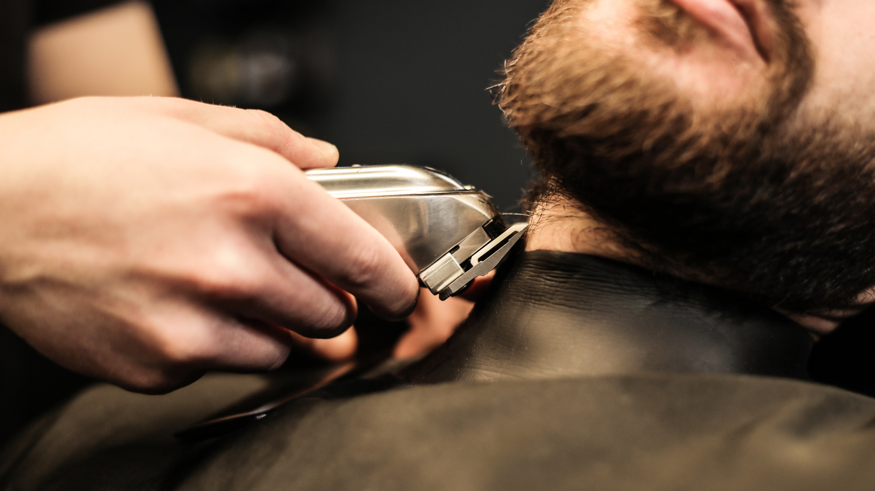
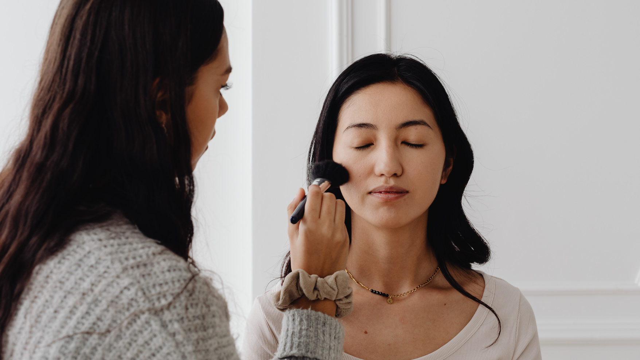
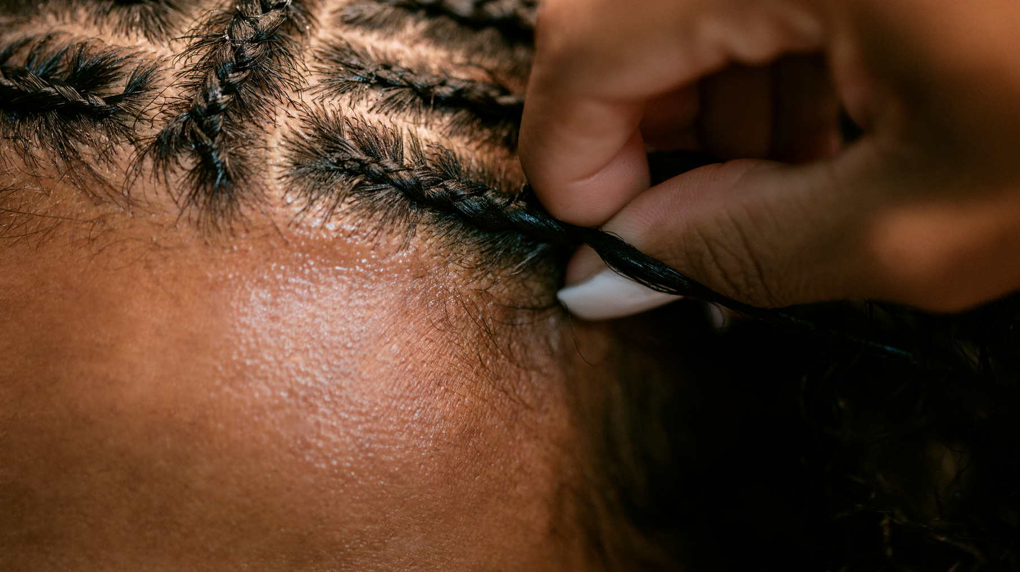
JOIN US!
WHY S.E.A. LEADERS?
MARCH 16-17, 2024
At S.E.A. Leaders, we are passionate about helping small businesses and medical professionals improve their customer experience.
Our team of experts provides customer experience design consulting, customer service training, and survey design and administration to ensure that your customers receive the best experience possible.
We work with you every step of the way to identify your unique needs and develop customized solutions that drive results.
From vendors, live demos, panelists, the brunch event and keynote speakers, you are truly in for a treat with the 2024 Beauty Conference!
We would love to have your support!

Slide 12
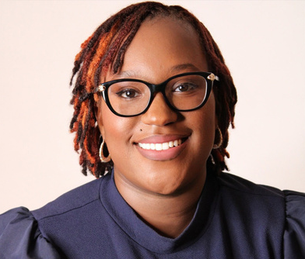
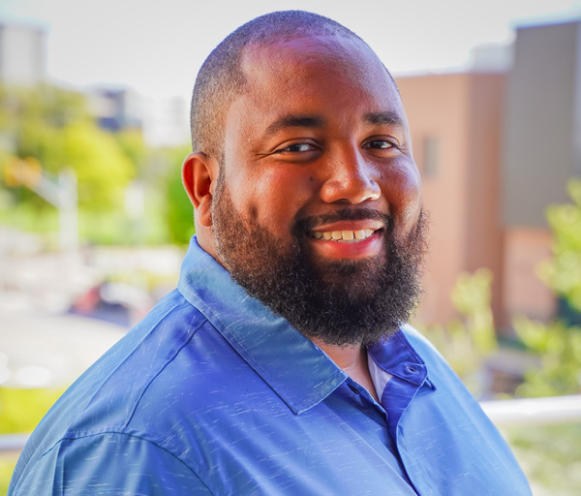
Meet the Team!
Jennica Anderson
David Anderson
CEO & Founder
Advisory Board Member
Jaylan Fisher
Jennifer Kelly
Advisory Board Member
Advisory Board Member
Ashley Bridges
Rhonda Holt
Advisory Board Member
Advisory Board Member

Slide 13
WE’D LOVE TO CONNECT WITH YOU!
THANK YOU FOR YOUR TIME!
Phone Number
855-732-5323
Jennica
Anderson
Email Address
trainininginfo@sealeadersinc.com
Founder
S.E.A. Leaders, Inc.
Our Website
www.sealeadersinc.com
Address
PO Box 361324 Indianapolis, IN 46236

